Slide 1

M.U.G.G.E. Mostyl Unfinished Genre Grading Engine
As a project of the class Machine Learning at the University of Hamburg

Slide 2
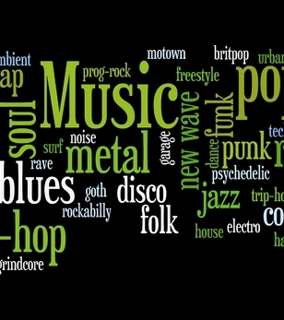

M.U.G.G.E. Mostly Unfinished Genre Grading Engine
As a project of the class Machine Learning at the University of Hamburg

Slide 3
Goals
…

Slide 4
Music Genres for Classifying
Blues
Classical
Country
Disco
Hip Hop
Jazz
Metal
Pop
Reggae
Rock

Slide 5
Dataset
1000 songs
100 songs for each genre
Audio duration: 30 seconds
Source of dataset: Kaggle.com, GTZAN Dataset-Music Genre Classification

Slide 6
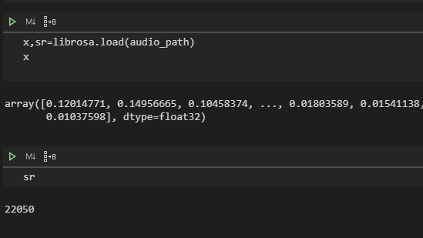
Python Audio Library Librosa
Load audio files
Extract features from audio files

Slide 7
Features
Zero Crossing rate
Spectral Centroid
Chroma Frequencies
Mel-Frequency Cepstral Coefficients
Chords

Slide 8
Zero Crossing Rate
The rate of sign-changes along a signal, i.e., the rate at which the signal changes from positive to negative or back.
Higher values for highly percussive sounds like those in metal and rock.
Librosa Function: librosa.zero_crossings()

Slide 9
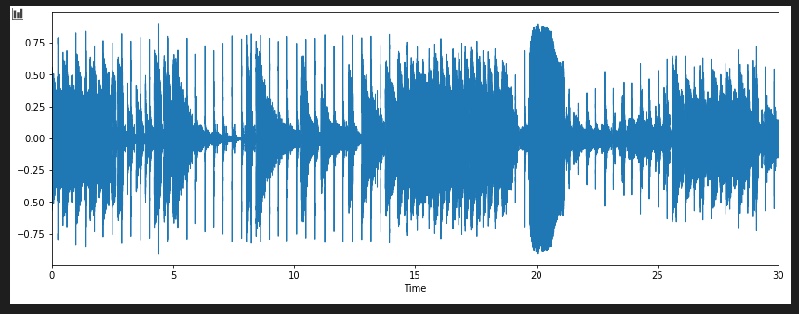
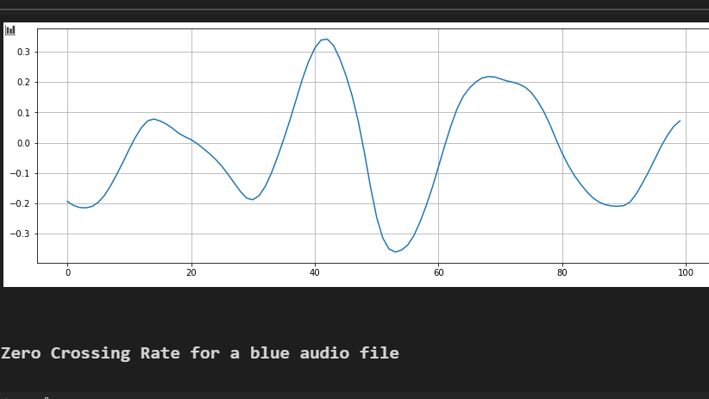
Sum of crossings for a Blues audio file : 7

Slide 10
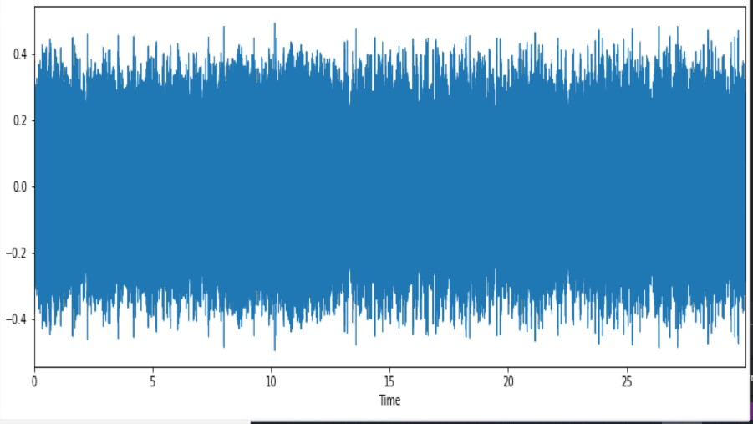
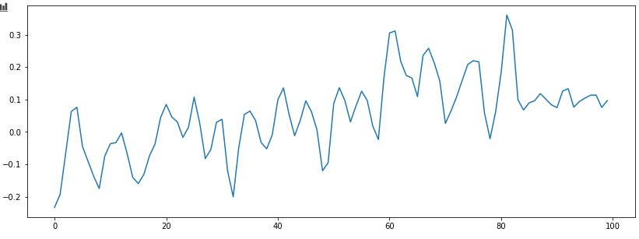
SUM OF CROSSINGS FOR A METAL AUDIO FILE: 19

Slide 11
Spectral Centroid

Slide 12
Chroma

Slide 13
MFCC
Small set of features (21 in our case)
Describe the overall shape of a spectral envelope
Human perception of speech/sound is linear until 1000 Hz Range(100-3200 Hz) and logarithmic from threre
Cepstrum is Fourier Transform (logarithmix ( Fourier Transform(Sound)))

Slide 14
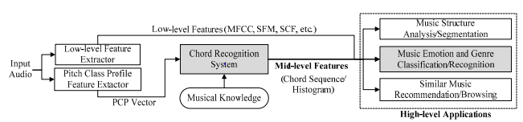
Chord Feature
Taking the Chromagramm and extract the Pitch Class Profile
Calculate the Transition Matrix
Train the Neural Network

Slide 15
Our models
LogisticRegression
RandomForests
SupportVectorMachine
Multi-Layer-Perceptron

Slide 16
Model Selection: Multi-Layer-Percepton (MLP)
Parameter grid with
hidden_layer_sizes: (100) , (100,50) and (50,50,50)
activation: ‘relu‘ and ‘logistic‘
solver: ‘lbfgs’ (quasi-Newton optimizer) and ’adam’ (based on stochastic gradient descent)
alpha: 0.0001 and 0.01
learning_rate: ‘constant‘, ‘invscaling’ and ‘adaptive’
max_iter: 250, 500 and 750

Slide 17
Model Selection: Multi-Layer-Percepton (MLP)
A cross-validated grid-search over this parameter grid (with GridSearchCV and Kfold) yielded:
 | Scaler | Hidden_layer_size | Activation | Solver | Alpha | Learning_rate | Max_iter | Score
All features |  | (100,50) | Logistic | adam | 0.0001 | Adaptive | 250
All except chords
Chroma
Spec
Zero
Mfcc
Chords

Slide 18
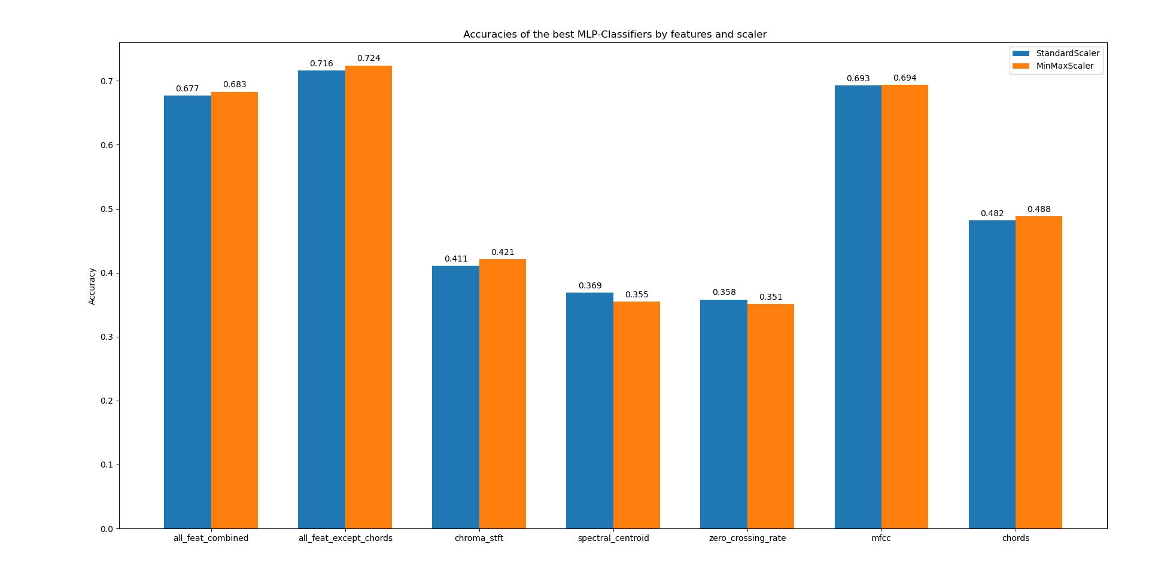

Slide 19
Another Model Selection? Randomforest Or svm?
Parameter grid with
….?

Slide 20
Another Model Selection? Randomforest Or svm?
A cross-validated grid-search over this parameter grid (with GridSearchCV and Kfold) yielded:
 | Scaler | Hidden_layer_size | Activation | Solver | Alpha | Learning_rate | Max_iter | Score
All features |  | (100,50) | Logistic | adam | 0.0001 | Adaptive | 250
All except chords
Chroma
Spec
Zero
Mfcc
Chords

Slide 21
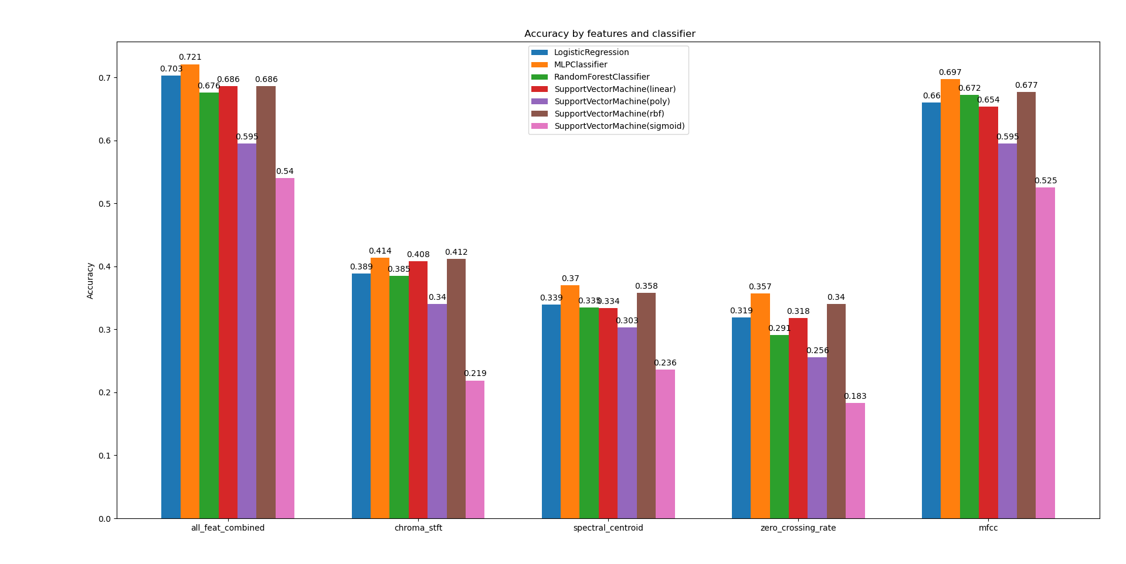
Evaluation

Slide 22
But what about recall, precision and f1-score?
Results are missing

Slide 23
Confusion Matrices

Slide 24
Maybe another slide on one of the following topics
Feature Importance
Impurity: Gini or entropy
Elbow graph
Decision tree: Visualization

Slide 25
Results on the decision algorithm
Results are still missing...

Slide 26
Input-Pipeline
Job:
input costum data to be classified.
arrange data to be accessible for the feature- and model boxes
Approach:
team needs 1-D numpy arrays of audio-samples, due to Librosa-specification
therefore, develop routine to read/record audio-files and convert these into required numpy arrays
libraries: pydub (requires: FFMPEG), sounddevice

Slide 27
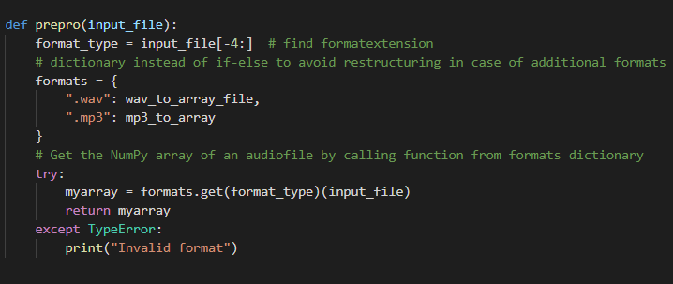
Input-Pipeline
Read & Convert Files:
input: File
master function reads and delegates tasks to appropriate functions
decided for WAV and MP3
use dictionary to make code easily extendable
return: array

Slide 28
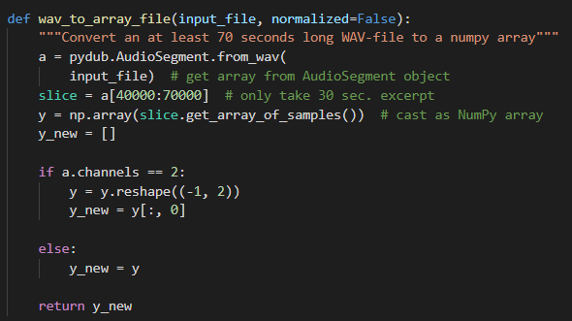
Input-Pipeline
Convert file to array:
input: file
only take 30 seconds of audio , needed for the classifyer
each channel has an independent audio signal, so taking one channel for samples should suffice
return: array

Slide 29
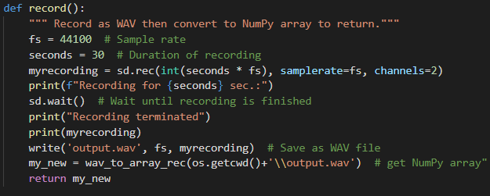
Input-Pipeline
Record:
record for 30 seconds to WAV
technical part outsourced to Sounddevice
convert WAV to array of samples
return: array

Slide 30
Outlook:
Possible next/further steps
Feature based: extract more features (eg. spectral-rollof), compare standard deviation with variance
Data based: Use 1million songs data set
Model based: scale with sklearn.Normalizer, cross-validated grid-search for all Classifiers
GUI?

Slide 31
Appendix

Slide 32
References
…

Slide 33
Project Plan
…

Slide 34
Code
You can find the code at:
https://github.com/MrGandalv/MUGGE

Slide 35
Music Genre classification

Slide 36
Music Genres for Classifying:
Blues
Classical
Country
Disco
Hip Hop
Jazz
Metal
Pop
Reggae
Rock

Slide 37
Dataset
1000 songs
100 songs for each genre
Audios Duration: 30 seconds
Source of dataset: Kaggle.com, GTZAN Dataset-Music Genre Classification

Slide 38
Python Audio Library Librosa:
Load audio files
Extract features from
audio files

Slide 39
Features
Zero Crossing rate
Spectral Centroid
Chroma Frequencies
Mel-Frequency Cepstral Coefficients
Chords

Slide 40
Zero Crossing Rate
The rate of sign-changes along a signal, i.e., the rate at which the signal changes from positive to negative or back.
Higher values for highly percussive sounds like those in metal and rock.
Librosa Function: librosa.zero_crossings()

Slide 41
Sum of crossings for a Blues audio file : 7

Slide 42
SUM OF CROSSINGS FOR A METAL AUDIO FILE: 19

Slide 43
Our models
LogisticRegression
RandomForests
SupportVectorMachine
Multi-Layer-Perceptron

Slide 44
Model Selection: Multi-Layer-Perceptron (MLP)
Parameter grid with
hidden_layer_sizes: (100) , (100,50) and (50,50,50)
activation: ‘relu‘ and ‘logistic‘
solver: ‘lbfgs’ (quasi-Newton optimizer) and ’adam’ (based on stochastic gradient descent)
alpha: 0.0001 and 0.01
learning_rate: ‘constant‘, ‘invscaling’ and ‘adaptive’
max_iter: 250, 500 and 750

Slide 45
Model Selection: Multi-Layer-Perceptron (MLP)
A cross-validated grid-search over this parameter grid (with GridSearchCV and Kfold) yielded:
 | Scaler | Hidden_layer_size | Activation | Solver | Alpha | Learning_rate | Max_iter | Score
All features |  | (100,50) | Logistic | adam | 0.0001 | Adaptive | 250
All except chords
Chroma
Spec
Zero
Mfcc
Chords

Slide 47
Another Model Selection? Randomforest Or svm?
Parameter grid with
….?

Slide 48
Another Model Selection? Randomforest Or svm?
A cross-validated grid-search over this parameter grid (with GridSearchCV and Kfold) yielded:
 | Scaler | Hidden_layer_size | Activation | Solver | Alpha | Learning_rate | Max_iter | Score
All features |  | (100,50) | Logistic | adam | 0.0001 | Adaptive | 250
All except chords
Chroma
Spec
Zero
Mfcc
Chords

Slide 49
Evaluation

Slide 50
But what about recall, precision and f1-score?
Results are still missing...

Slide 51
Confusion MAtrices

Slide 52
Maybe another slide on one of the following topics
Feature Importance
Impurity: Gini or entropy
Elbow graph
Decision tree: Visualization

Slide 53
Results on the decision algorithm
Results are still missing...

Slide 54
Outlook
Possible next/further steps
Feature based: extract more features (eg. spectral-rollof), compare standard deviation with variance
Data based: Use 1million songs data set
Model based: scale with sklearn.Normalizer, cross-validated grid-search for all Classifiers
GUI?

